Slide 1
Source Control (GIT)
Bolzano, 22/10/2020
Stefano Primo, Developer Labs

Slide 2
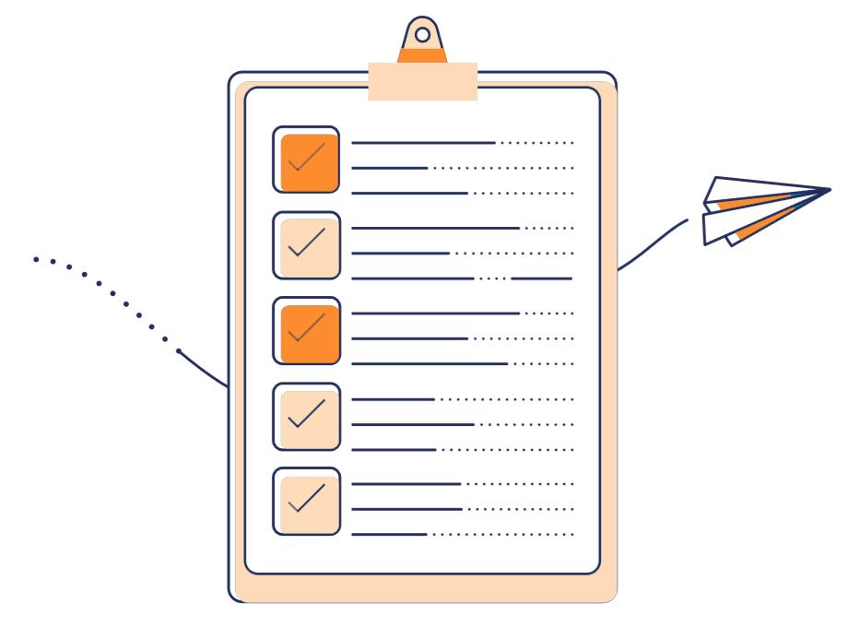
Agenda
01
What is GIT
02
How to use Git
Pull, Push, Commit
03
Git with VS Code
Using of GitGraph and GitLense
04
Branch and PullRequests
How to properly use branches and creating Pull Requests

Slide 3

What is GIT
A Distributed Version Control System
Developed in 2005 by Linus Torvalds for use on the Linux Kernel

Slide 4
Why using a version control
Track all your changes
Work along with others
Share work with others
With Git

Slide 5
How does GIT work?
Maintains a repository of changes to a folder
The directory can be “saved” (committed) or “opened” (checked out) at any version

Slide 6
GIT Workflow
Make some changes
Stage the changes
Commit
Push

Slide 7
How to use GIT
USE THE CMD!

Slide 8
How to use GIT - Clone
Command:
git clone ‘URL’
Example:
git clone https://github.com/stefanoPrimo/HowToUseGit
Clone a repository into a new directory

Slide 9
How to use GIT - Init
Command:
git init
Example:
mkdir MyNewRepo
git init
Create an empty Git repository or reinitialize an existing one

Slide 10
How to use GIT – Stage the changes
Command:
git add
Example:
git add .
Add file contents to the index

Slide 11
How to use GIT – Commit
Command:
git commit
Example:
git commit –a –m «My Commit Message»
Record changes to the repository
If using the commit editor, press “esc” and type “:x!” then “Enter”

Slide 12
How to use GIT – Log
Command:
git log
Example:
git log
Shows the commit history

Slide 13
How to use GIT – Push
Command:
git push
Example:
git push
Update remote refs along with associated objects

Slide 14
How to use GIT – Pull
Command:
git pull
Example:
git pull
Fetch from and integrate with another repository or a local branch

Slide 15

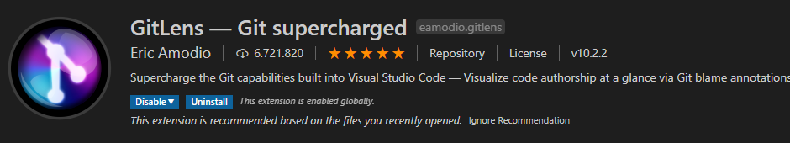
How to use GIT with VS Code
CLI? No Thanks*
Fortunately we use Visual Studio Code and some good samaritan has created for us some usefull extensions like:
* This may not be an option in some cases

Slide 16



Grazie!

